Slide 1
Data Science Salary Analysis & Recommendations
By Peter Jordan

Slide 2
Introduction & Objective
Purpose of the Analysis:
Our company plans to hire a full-time data scientist to lead data-driven decision-making.
The goal is to determine a competitive salary range to attract top talent.
The position can be U.S.-based or offshore, depending on cost and talent availability.
Key Questions:
What is the typical salary range for data science roles?
How do experience levels impact pay?
What is the difference between U.S. and non-U.S. salaries?
What would be a realistic and competitive range for a small but growing company?
The following analysis explores global data to answer these questions and guide compensation decisions.

Slide 3
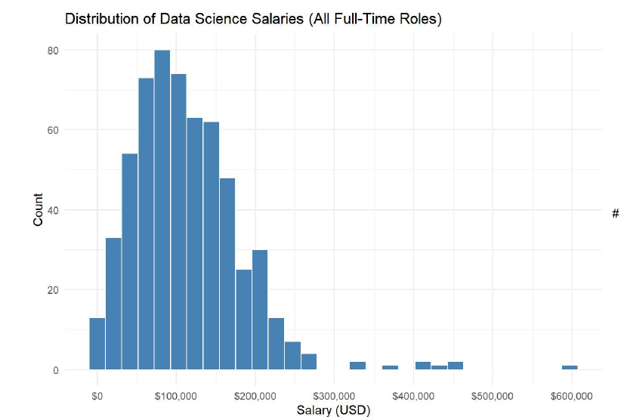
Overall Salary Overview
The median global salary for full-time data science roles is about $104,000 USD.
The average salary is slightly higher, around $113,000, showing a few high-earning outliers.
The middle 50% of salaries fall between $65,000 and $150,000 USD.
Salary differences are primarily driven by experience, geography, and company size.

Slide 4
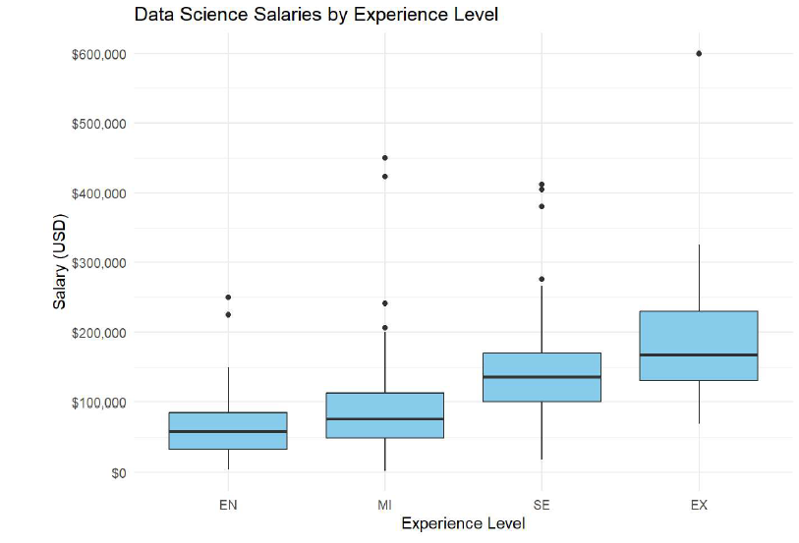
Salaries by Experience Level
Salaries rise steadily with experience level.
Entry-level (EN): Median around $59K, average $64K.
Mid-level (MI): Median around $77K, average $88K.
Senior-level (SE): Median around $136K, average $139K.
Executive-level (EX): Median around $168K, average $191K — with top earners above $600K.
As experience increases, so does value — senior and executive data scientists earn over twice as much as entry-level hires.

Slide 5
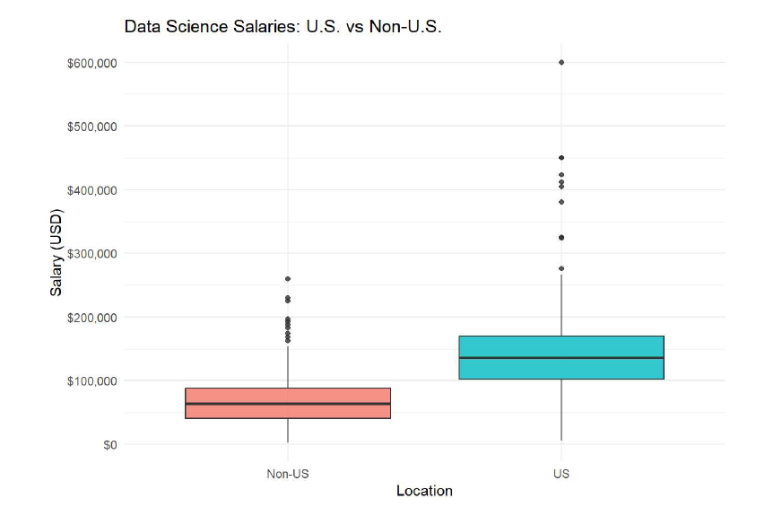
U.S. vs. Non-U.S. Data Science Salaries
U.S.-based data scientists earn significantly more than Non-U.S. professionals.
Median Salary: U.S. ≈ $136K | Non-U.S. ≈ $64K
Average Salary: U.S. ≈ $145K | Non-U.S. ≈ $69K
The gap reflects differences in market demand, cost of living, and regional competition for technical talent.
Offshore roles offer cost savings but may limit access to senior or leadership-level expertise.

Slide 6
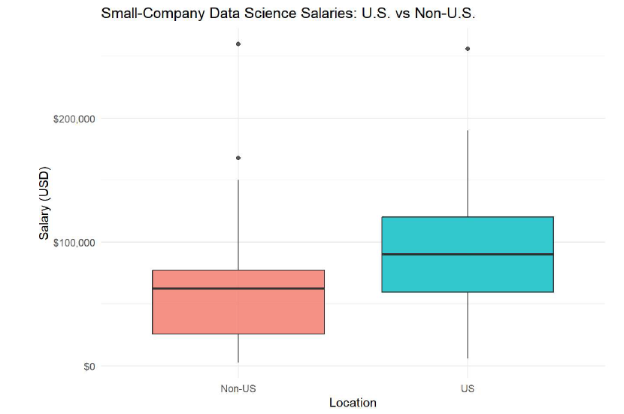
Small-Company Salaries
Among small companies (<50 employees), salaries are lower overall than larger firms.
U.S. small-company median: ≈ $90K (average ≈ $98K)
Non-U.S. small-company median: ≈ $63K (average ≈ $64K)
The salary gap remains — U.S. roles earn about 40–50% more than offshore ones.
This reflects both market maturity and talent availability in each region.
Insight: Even at smaller firms, U.S. data scientists earn roughly 40–50% more than offshore peers — a critical factor in defining a competitive, sustainable pay range.

Slide 7
Final Recommendation to the CEO
After analyzing global data on data science salaries, several clear patterns emerged:
  Salaries increase sharply with experience level.
  U.S.-based roles pay nearly double those outside the U.S.
  Small companies typically offer lower pay but remain competitive when strategically aligned.
To attract and retain qualified talent while managing costs:
  Offer $110K–$140K for a U.S.-based Data Scientist.
  Offer $70K–$90K for a Non-U.S. (offshore) hire.
This range positions the company to:
  Stay competitive in the U.S. market,
  Leverage cost-effective offshore options, and
  Build a scalable foundation for future data science expansion.
  Recommendation Summary: These recommendations provide a foundation for sustainable growth as the company expands its data capabilities.

